Slide 1
Day one
Chapter 12
Air
Section 1: What Cause Air Pollution?

Slide 2
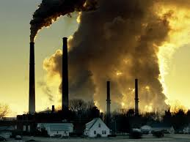
What Causes Air Pollution?
Air pollution is the contamination of the atmosphere by wastes from sources such as industrial burning and automobile exhausts.
Can be solid, liquid, or gas
Most air pollution is the results from human activities
Some air pollution is natural
Dust, pollen, spores, and sulfur dioxide from volcanic eruptions.

Slide 3
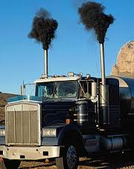
Primary and Secondary Pollutants
A primary pollutant is a pollutant that is put directly into the atmosphere by human or natural activity.
Ex: soot from smoke
A secondary pollutant is a pollutant that forms in the atmosphere by chemical reactions with primary air pollutants, natural components in the air, or both.
Ex: ground-level ozone
Ground level ozone forms when the emission from cars react with the UV rays of the sun and then mix with the oxygen in the atmosphere.

Slide 4
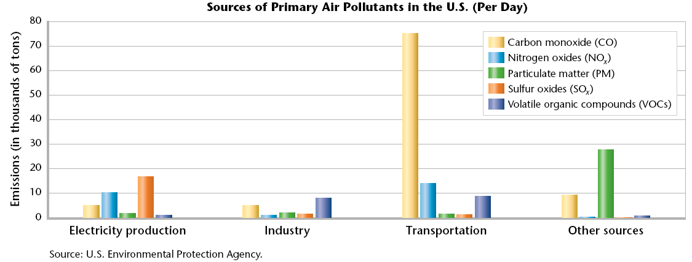
Primary Pollutants

Slide 5
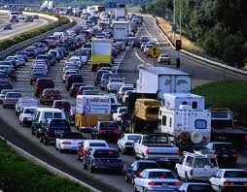
Sources of Primary Air Pollutants
Primary pollutant sources:
Household products
Power plants
Motor vehicles are sources of primary pollutants such as carbon monoxide, nitrogen oxide, sulfur dioxide, and chemicals called volatile organic compounds (VOCs).
Primary pollutants:
Carbon monoxide
Nitrogen oxide
Sulfur dioxide
Volatile Organic Compounds (VOC’s)

Slide 6
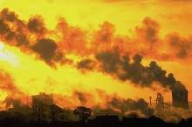
Sources of Primary Air Pollutants
Vehicles and coal-burning power plants are the major sources of nitrogen oxide emissions.
Power plants, refineries, and metal smelters contribute much of the sulfur dioxide emissions.
Vehicles and gas stations make up most of the human-made emissions of VOCs.

Slide 7
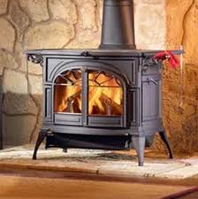
Sources of Primary Air Pollutants
Particulate matter can also pollute the air
Divided into fine and coarse particles.
Fine particles enter the air from fuel burned by vehicles and coal-burning power plants.
Sources of course particles
cement plants
mining operations
incinerators
wood-burning fireplaces
fields and roads

Slide 8
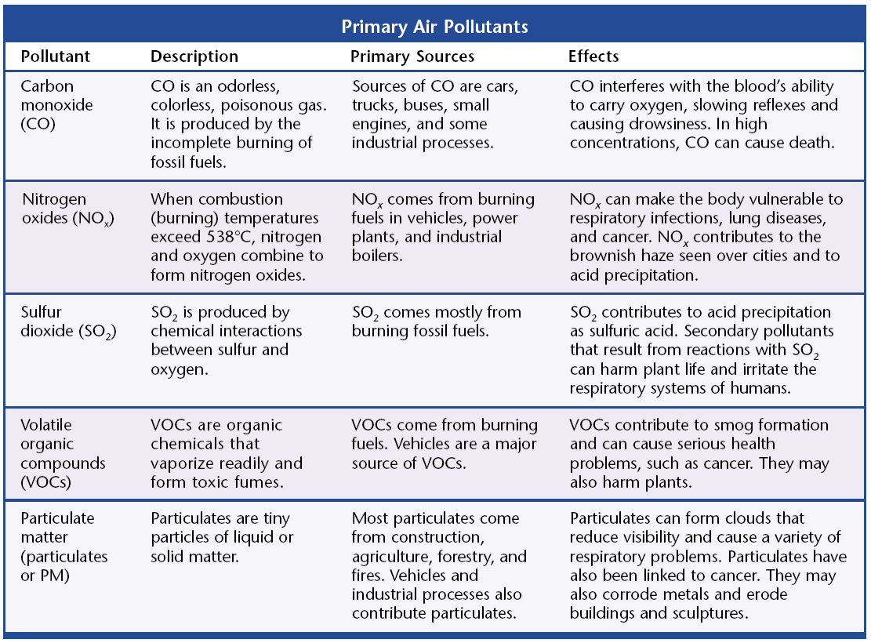
Sources of Primary Air Pollutants

Slide 9
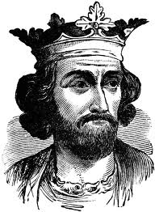
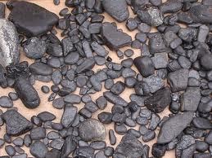
The History of Air Pollution
Air pollution is not a new phenomenon.
History Fact: 1273: King Edward I ordered that burning a particularly dirty kind of coal called sea-coal was illegal.
The world’s air quality problem is much worse today because modern industrial societies burn large amounts of fossil fuels.
Most air pollution in urban areas comes from vehicles and industry.

Slide 10
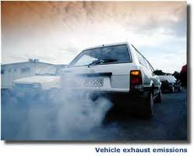
Motor Vehicle Emissions
Almost 1/3 of our air pollution comes from gasoline burned by vehicles.
According to the U.S. Department of Transportation, Americans drove their vehicles over 2.6 trillion miles in 1998.
Over 90 percent of that mileage was driven by passenger vehicles. The rest was driven by trucks and buses.

Slide 11
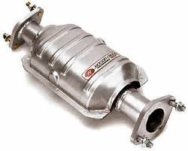
Controlling Vehicle Emissions
The Clean Air Act, passed in 1970 and strengthened in 1990, gives the Environmental Protection Agency (EPA) the authority to regulate vehicle emissions in the United States.
The EPA required the gradual elimination of lead in gasoline, decreasing lead pollution by more than 90 percent in the United States.
In addition, catalytic converters, required in all automobiles, clean exhaust gases of pollutants before pollutants are able to exit the tail pipe.

Slide 12
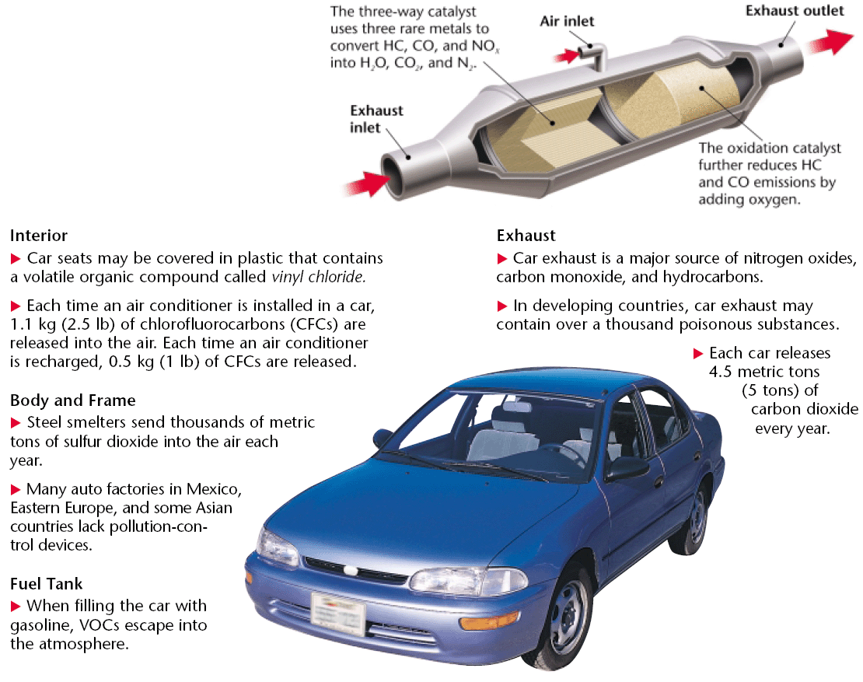
Controlling Vehicle Emissions

Slide 13
California Zero-Emission Vehicle Program
In 1990, the California Air Resources Board established the zero-emission vehicle (ZEV) program.
Zero-emission vehicles are vehicles that have no
Tailpipe emissions
No emissions from gasoline
No emission-control systems that deteriorate over time.
By 2016, 16 percent of all vehicles sold in California are required to be zero-emission vehicles, including SUVs and trucks.

Slide 14
Industrial Air Pollution
Many industries and power plants that generate our electricity must burn fuel, usually fossil fuel, to get the energy they need.
Burning fossil fuels releases huge quantities of sulfur dioxide and nitrogen oxide into the air.
Power plants that produce electricity emit at least two-thirds of all sulfur dioxide and more than one-third of all nitrogen oxides that pollute the air.

Slide 15
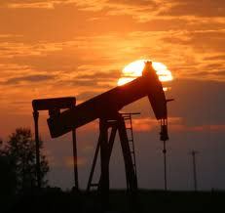
Industrial Air Pollution
Some industries also produce VOCs, which are chemical compounds that form toxic fumes.
Examples:
Dry cleaning
Oil refineries
Chemical manufacturing plants
Furniture refinishers
Automobile repair shops
When people use some of the products that contain VOCs, even more VOCS are added to the air.

Slide 16
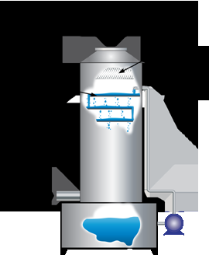
Regulating Air Pollution From Industry
The Clean Air Act requires many industries to use scrubbers or other pollution-control devices.
Scrubbers remove some of the more harmful substances that would otherwise pollute the air.
A scrubber is a machine that moves gases through a spray of water that dissolves many pollutants.
Ammonia is an example of a pollutant gas that can be removed from the air by a scrubber.

Slide 17
Regulating Air Pollution From Industry
Electrostatic precipitators are machines used in cement factories and coal-burning power plants to remove dust particles from smokestacks.
In an electrostatic precipitator, gas containing dust particles is blown through a chamber containing an electrical current.
An electric charge is transferred to the dust particles, causing them to stick together and to the sides of the chamber.

Slide 18
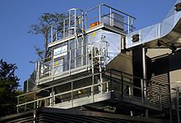
Electrostatic Precipitator
The clean gas is released from the chamber and the concentrated dust particles can then be collected and removed.
Electrostatic precipitators remove 20 million tons of ash generated by coal-burning power plants from the air each year in the United States.

Slide 19
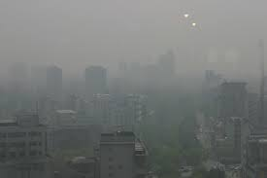
Smog
Smog is urban air pollution composed of a mixture of smoke and fog produced from industrial pollutants and burning fuels.
Smog results from chemical reactions that involve sunlight, air, automobile exhaust, and ozone.
Pollutants released by vehicles and industries are the main causes of smog.

Slide 20
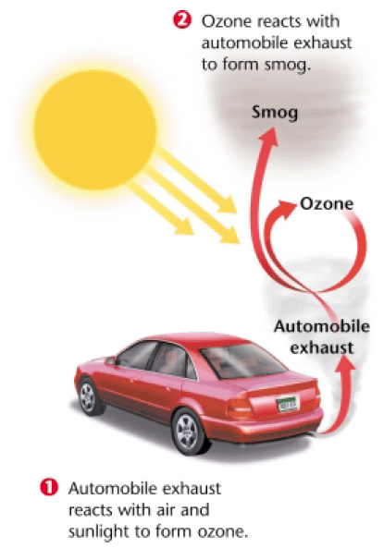
Smog

Slide 21
Temperature Inversions
The circulation of air in the atmosphere usually keeps air pollution from reaching dangerous levels.
During the day, the sun heats the surface of the Earth and the air near the Earth.
The warm air rises through the cooler air above it and carries pollutants away from the ground, and into the atmosphere.
Sometimes, however, pollution is trapped near the Earth’s surface by a temperature inversion.

Slide 22
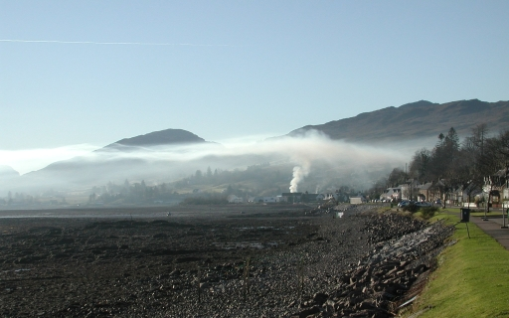
Temperature Inversions
A temperature inversion is the atmospheric condition in which warm air traps cooler air near Earth’s surface.
The warmer air above keeps the cooler air at the surface from moving upward so, pollutants are trapped below with the cooler air.
If a city is located in a valley, it has a greater chance of experiencing temperature inversions. Los Angeles, surrounded on three sides by mountains, often has temperature inversions.

Slide 23
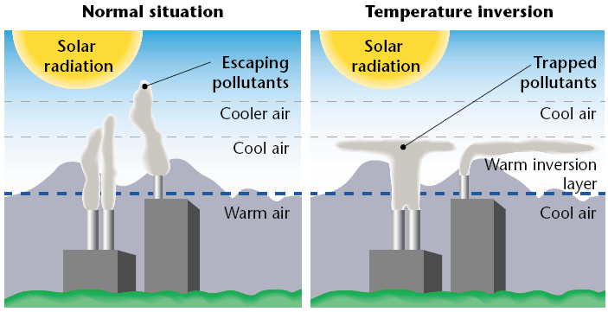
Temperature Inversions

Slide 24
Air Pollution Video

Slide 25
Ticket out the Door
What is air pollution?
What is the cause of most air pollution?
What is the difference between a primary and secondary pollutant?
List two examples of primary pollutants.
What are the two examples of particulate air matter?
What is smog?

