Slide 1
Day one
Chapter 12, Air
Section 3: Acid Precipitation

Slide 2
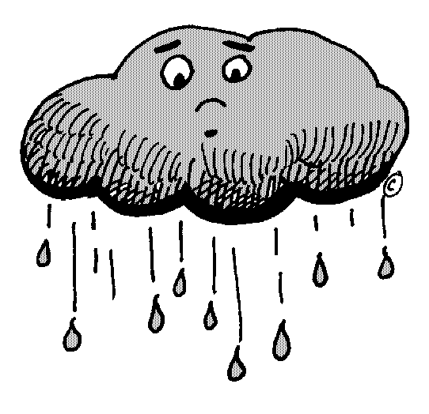
What Causes Acid Precipitation?
Acid precipitation is precipitation, such as rain, sleet, or snow that contains a high concentration of acids, often because of the pollution of the atmosphere.
When fossil fuels are burned, they release oxides of sulfur and nitrogen.
When these oxides combine with water in the atmosphere they form sulfuric acid and nitric acid, which falls as acid precipitation.

Slide 3
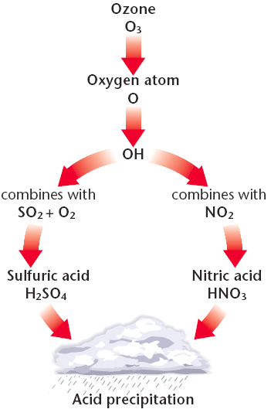
What Causes Acid Precipitation?

Slide 4
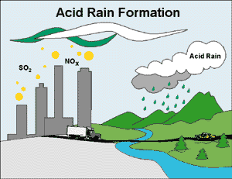
What Causes Acid Precipitation?
This acidic water flows over and through the ground, and into lakes, rivers, and streams.
Acid precipitation can kill living things, and can result in the decline or loss of some local animal and plant populations.

Slide 5
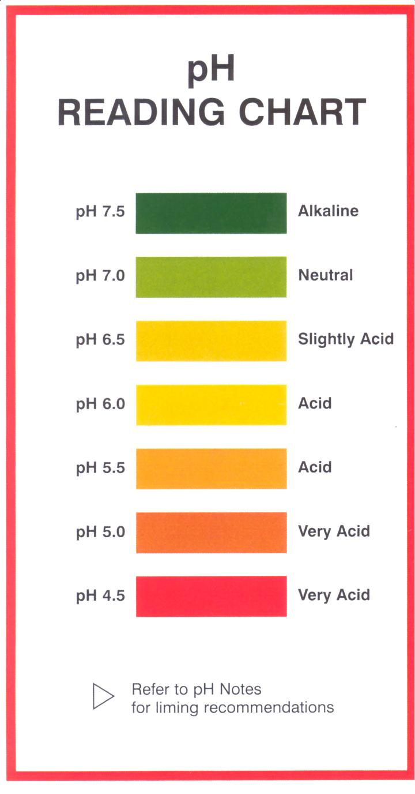
What Causes Acid Precipitation?
A pH number is a value that is used to express the acidity or alkalinity (basicity) of a system.
Each whole number on the scale indicates a tenfold change in acidity.
A pH of 7 is neutral.
A pH of less than 7 is acidic.
A pH of greater than 7 is basic.
Pure water has a pH of 7.0, while normal precipitation has a pH of about 5.6.

Slide 6
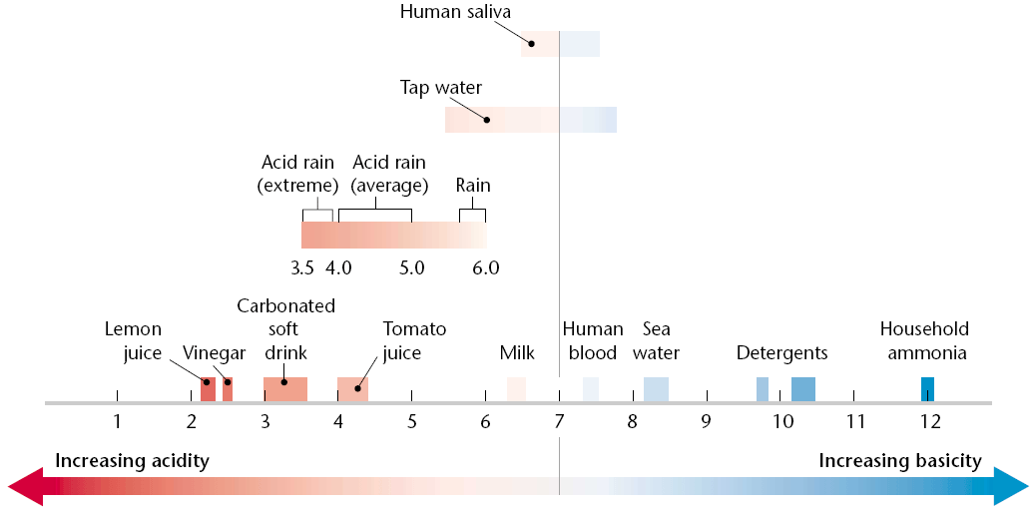
What Causes Acid Precipitation?

Slide 7
What Causes Acid Precipitation?
Normal precipitation is slightly acidic because atmospheric carbon dioxide dissolves into the precipitation and forms carbonic acid.
Precipitation is considered acid precipitation if it has a pH of less than 5.0
The pH of precipitation varies among different geographic areas.
Example: The pH of precipitation in the eastern U.S. and Canada ranges from 4.2 to 4.8
Most acidic precipitation occurring around Lake Erie and Lake Ontario.

Slide 8
How Acid Precipitation Affects Soils and Plants
Acid precipitation can cause a drop in the pH of soil and water. This increase in the concentration of acid is called acidification.
When the acidity of soil increases, some nutrients are dissolved and washed away by rainwater.
It also causes aluminum and other toxic metals to be released and possibly absorbed by the roots of plants causing root damage.
Sulfur dioxide in water vapor clogs the openings on the surfaces of plants.

Slide 9
Acid Precipitation and Aquatic Ecosystems
Aquatic animals are adapted to live in an environment with a particular pH range.
The result of acid precipitation on a lake can kill aquatic plants and animals.
In addition, acid precipitation causes aluminum to leach out of the soil surrounding a lake.
Aluminum accumulates in the gills of fish and interferes with oxygen and salt exchange.
End result ->fish are slowly suffocated

Slide 10
Acid Precipitation and Aquatic Ecosystems
Acid shock is the sudden runoff of large amounts of highly acidic water into lakes and streams when snow melts in the spring or when heavy rains follow a drought.
This phenomenon causes large numbers of fish to die, and affects the reproduction of fish and amphibians that remain.
Produce fewer eggs, and those eggs often do not hatch.
Offspring that do survive end up with birth defects and cannot reproduce.

Slide 11
Acid Precipitation and Aquatic Ecosystems
To counteract the effects of acid precipitation on aquatic ecosystems, some states in the U.S. and some countries spray:
Powdered limestone (calcium carbonate) to help restore their natural pH.
Because lime has a pH that is basic, the lime raises the pH of the water.
Unfortunately, enough lime cannot be spread to offset all acid damage to lakes.

Slide 12
Acid Precipitation and Humans
Toxic metals:
Aluminum
Mercury
Can be released into the environment when soil acidity increases.
These toxic metals can find their way into crops, water, and fish. The toxins then poison the human body.
Possible connection between large amounts of acid precipitation and respiratory problems in young children.

Slide 13
Acid Precipitation and Humans
The standard of living for some people is affected by acid precipitation.
Causes of acid precipitation on humans can:
Decrease the numbers of fish affect commercial fishermen and the sport-fishing industry
Trees are damaged by acid precipitation
Acid precipitation can dissolve the calcium carbonate in common building materials, such as concrete.

Slide 14
International Conflict
One problem in controlling acid precipitation is that pollutants may be released in one geographical area and fall to the ground hundreds of kilometers away.
For example, almost half of the acid precipitation that falls in southeastern Canada results from pollution produced in Ohio, Indiana, Pennsylvania, Illinois, Missouri, West Virginia, and Tennessee.

Slide 15
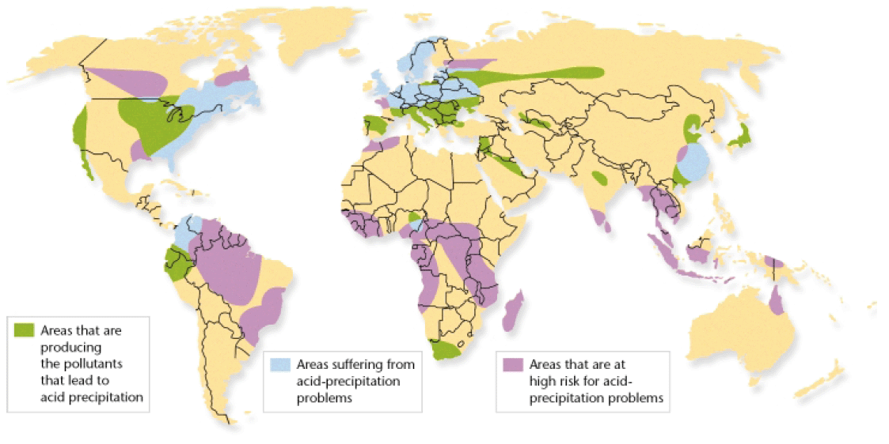
International Conflict

Slide 16
International Cooperation
Because acid precipitation falls downwind, the problem of solving acid precipitation has been difficult, especially on the international level.
Canada and the United States signed the Canada-U.S. Air Quality Agreement in 1991.
Both countries agreed to reduce acidic emissions that flowed across the Canada-U.S. boundary.
More international agreements such as this may be necessary to control the acid-precipitation problem.

Slide 17
Coal Combustion and Acid Rain

Slide 18
How Stuff Works: Energy and Acid Rain

Slide 19
Tim and Moby pH Scale Video

Slide 20
Ticket out the Door
What is acid precipitation?
What two acids fall in acid precipitation?
A pH of 7 is considered what?
A pH of less than 7 is considered what?
A pH of greater than 7 is considered what?
What is acidification?

