Slide 1
Day one
Chapter 12 , Air
Section 2: Air, Nose, and Light Pollution

Slide 2
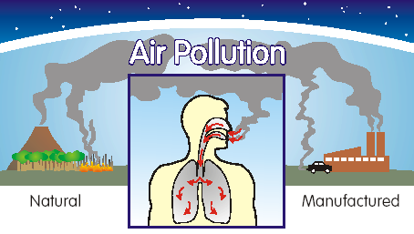
Air Pollution
Serious health problems, especially for people who are very young, very old, or who have heart or lung problems.
Air pollution adds to the effects of existing diseases such as emphysema, heart disease, and lung cancer.
The American Lung Association has estimated that Americans pay tens of billions of dollars a year in health costs to treat respiratory diseases caused by air pollution.

Slide 3
Short-Term Effects of Air Pollution on Health
Many of the effects of air pollution on people’s health are short-term and reversible if their exposure to air pollution decreases.
The short-term effects of air pollution on people’s health include
headache
nausea
irritation to the eyes, nose, and throat
coughing
tightness in the chest and upper respiratory infections, such as bronchitis and pneumonia.
Pollution can also make the conditions of asthma and emphysema worse for certain individuals.

Slide 4
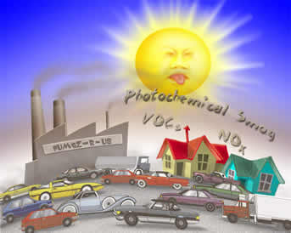
Long-Term Health Effects of Air Pollution
Long-term effects on health that have been linked to air pollution include:
emphysema
lung cancer
heart disease.
Long-term exposure to air pollution may worsen medical conditions suffered by older people and may damage the lungs of children.

Slide 5
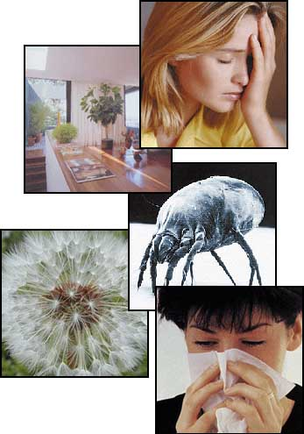
Indoor Air Pollution
The quality of air inside a home or building is sometimes worse than the quality of air outside.
Major sources of pollution:
Plastics
Industrial chemicals
These compounds can be found in
Carpets
Building materials
Paints
Furniture

Slide 6
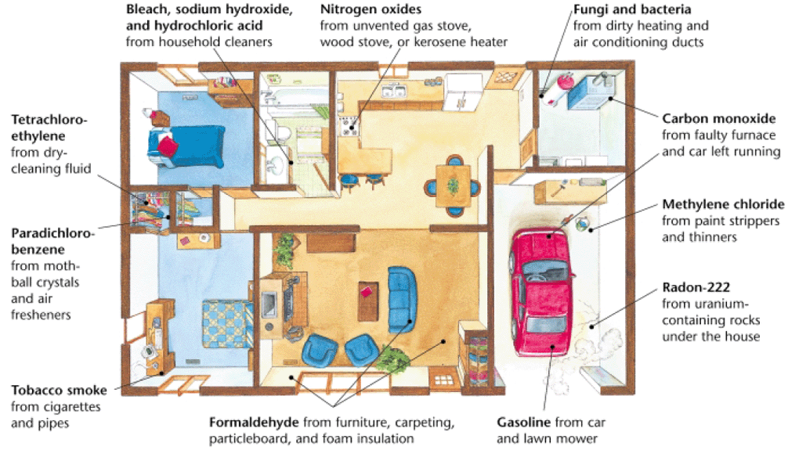
Indoor Air Pollution

Slide 7
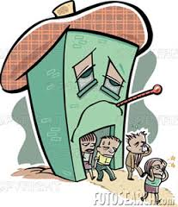
Indoor Air Pollution
Sick-building syndrome is a set of symptoms can affect workers in airtight office buildings:
headache
fatigue
eye irritation
dizziness
Sick-building syndrome is believed to be caused by indoor air pollutants.
Sick-building syndrome is most common in hot places where buildings are tightly sealed to keep out the heat.

Slide 8
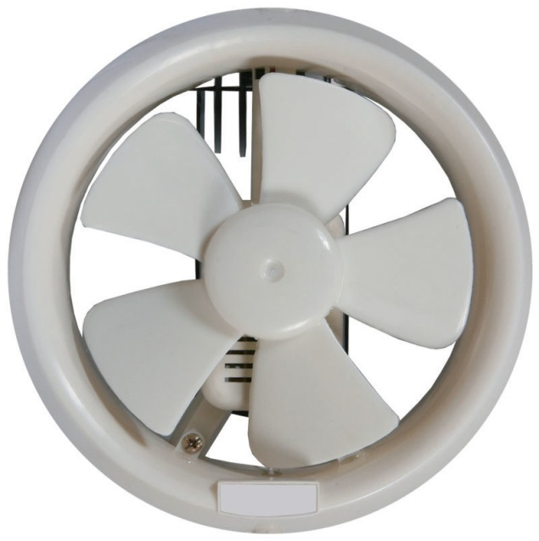
Indoor Air Pollution
Identifying and removing the sources of indoor air pollution is the most effective way to maintain good indoor quality.
Ventilation, or mixing outdoor air with indoor air, is also necessary for good air quality.
When activities such as renovation and painting, which cause indoor air pollution, are undertaken, ventilation should be increased.

Slide 9
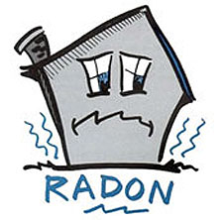
Radon Gas
Radon gas is colorless, tasteless, odorless, and radioactive.
Radon is one of the elements produced by the decay of uranium, a radioactive element that occurs naturally in the Earth’s crust.
Radon can seep through cracks and holes in foundations into homes, offices, and schools, where it adheres to dust particles.

Slide 10
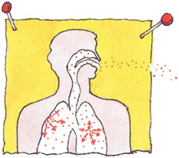
Radon Gas
When people inhale the dust, radon enters their lungs. In the lungs, radon can destroy the genetic material in cells that line the air passages.
Such damage can lead to cancer, especially among people who smoke.
Radon is the second-leading cause of lung cancer in the United States.

Slide 11
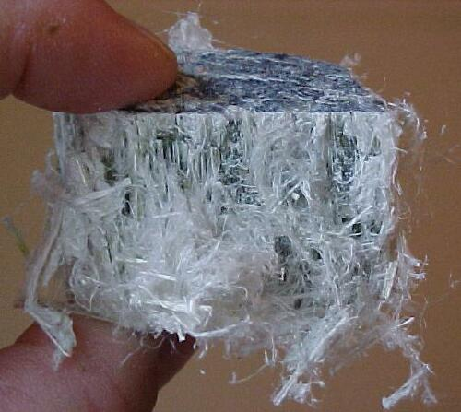
Asbestos
Asbestos is any of six silicate minerals that form bundles of minute fibers that are heat resistant, flexible, and durable.
Asbestos is primarily used as an insulator and as a fire retardant, and it was used extensively in building materials.
However, for all of its uses, the government banned the use of most asbestos products in the early 1970s.

Slide 12
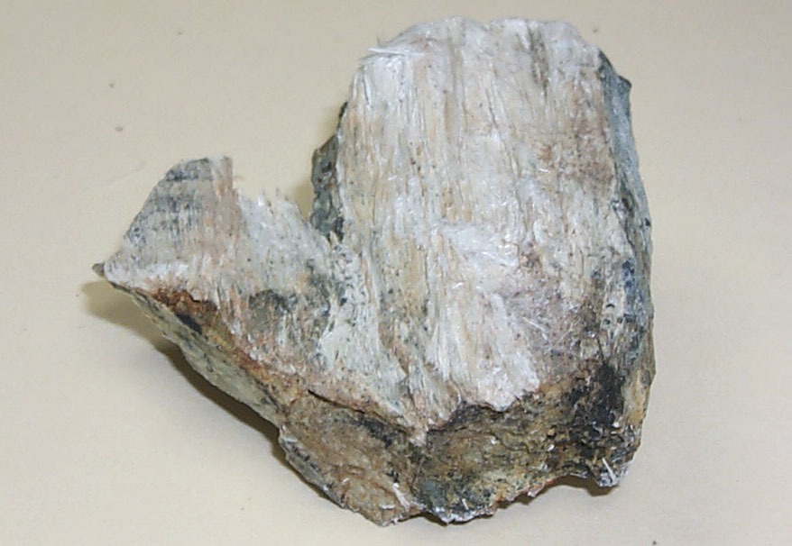
Asbestos
That was because exposure to asbestos in the air is very dangerous.
Asbestos fibers can cut and scar the lungs, causing the disease asbestosis.
Victims of the disease have more and more difficulty breathing and may eventually die of heart failure.

Slide 13
Noise Pollution
A sound of any kind is called a noise. However, some noises are unnecessary and can cause noise pollution.
Health problems that can be caused by noise pollution include
loss of hearing
high blood pressure
stress
Noise can also cause loss of sleep, which may lead to decreased productivity at work and in the classroom.

Slide 14
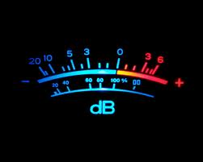
Noise Pollution
A decibel is the most common unit used to measure loudness, and is abbreviated dB.
The quietest sound that a human ear can hear is represented by 0 dB.
For each increase in decibel intensity, the decibel level is 10 times higher than the previous level.
A sound of 120 dB is at the threshold of pain. Permanent deafness may come as a result of continuous exposure to sounds over 120 dB.

Slide 15
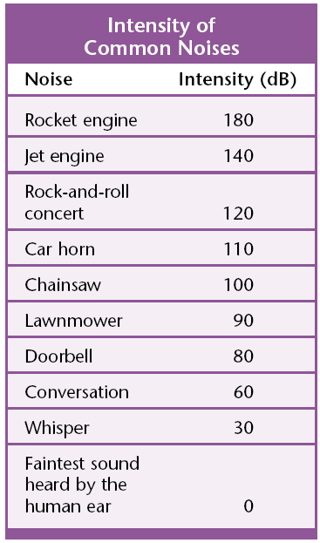
Noise Pollution

Slide 16
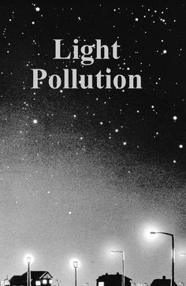
Light Pollution
Light pollution does not present a direct hazard to human health, but it does negatively affect our environment.
The use of inefficient lighting in urban areas is diminishing our view of the night sky.
In urban areas, the sky is often much brighter than the natural sky.

Slide 17
Light Pollution
A more important environmental concern of inefficient lighting is energy waste.
Energy is wasted when a light is directed upward into the night sky and lost to space.
Examples:
lighting on billboards
poor-quality street lights
the lighting of building exteriors
Solutions to this problem:
Shielding light so it is directed downward
Using time controls so that light is used only when needed
Using low-pressure sodium sources, which are the most energy-efficient sources of light

Slide 18
Human Pollution YouTube Video

Slide 19
Noise Pollution YouTube Video

Slide 20
Asbestos YouTube Video

Slide 21
Ticket out the Door
List three short-term effects of air pollution on a person’s health.
List three long-term effects of air pollution on a person’s health.
What are major sources of indoor air pollution?
What is sick building syndrome caused by?
How is radon produced?

